Slide 1

GIS details
Peter Galante
Biodiversity Informatics Scientist
Center for Biodiversity and Conservation
American Museum of Natural History

Slide 2
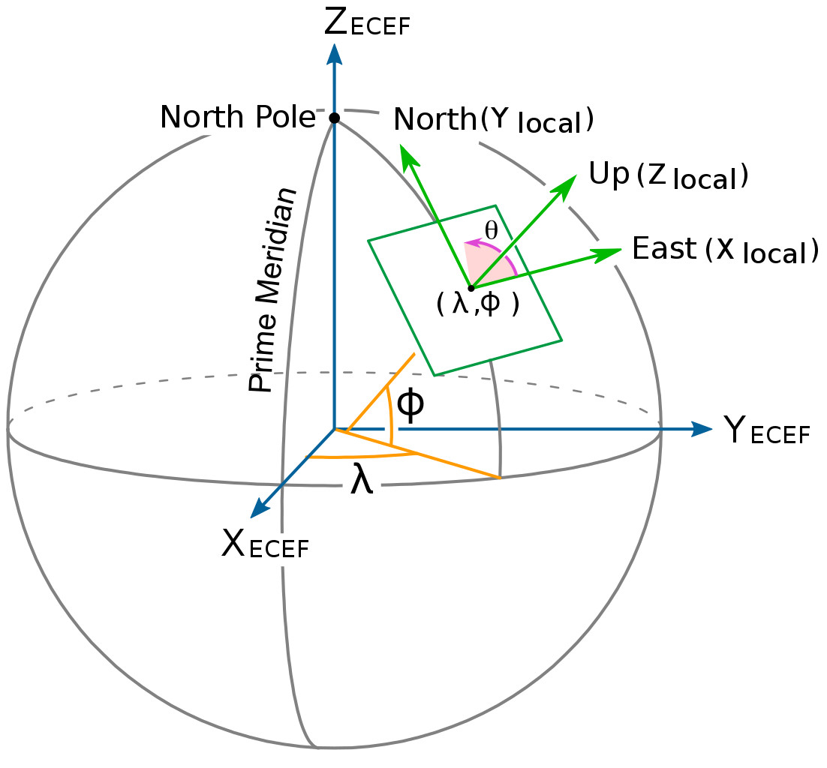
GIS fundamentals: Geographic coordinate systems (GCS)
A point is referenced by its longitude and latitude, which are angles measured from the Earth’s center to a point on its surface.
Latitude is also the angle from Polaris to horizon (in N. hemisphere)
Latitude and longitude are measured either in decimal degrees or in degrees, minutes and seconds.

Slide 3
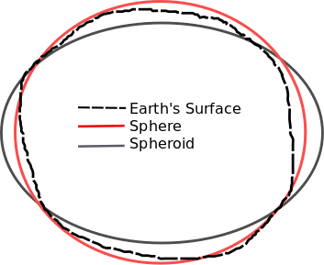
GIS fundamentals: Geographic coordinate systems (GCS)
The shape and size of a GCS’s surface is defined by a sphere or a spheroid
In fact, the Earth is neither a perfect sphere nor spheroid (the South Pole is closer to the equator than the North pole!)
A datum defines the origin and orientation of latitude and longitude lines.
Changing a GCS’s spheroid or datum changes all values!
The standard global system is called World Geodetic System 1984 (WGS1984)

Slide 4
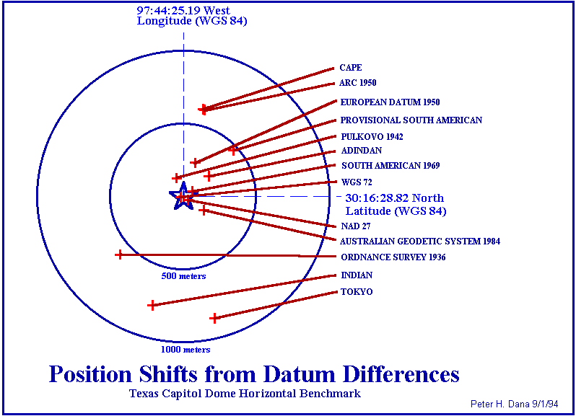
GIS fundamentals: Geographic coordinate systems (GCS)

Slide 5
GIS fundamentals: Geographic coordinate systems (GCS)
WGS84
Default Datum for GPS units
Pretty good for global measurements
Small changes in landmass movements can be significant at global scale
Melting glaciers cause rising elevation
Tectonic movements
Local datums are better for local maps (e.g., North American Datum; NAD83) and reduce significance of landmass movements.

Slide 6
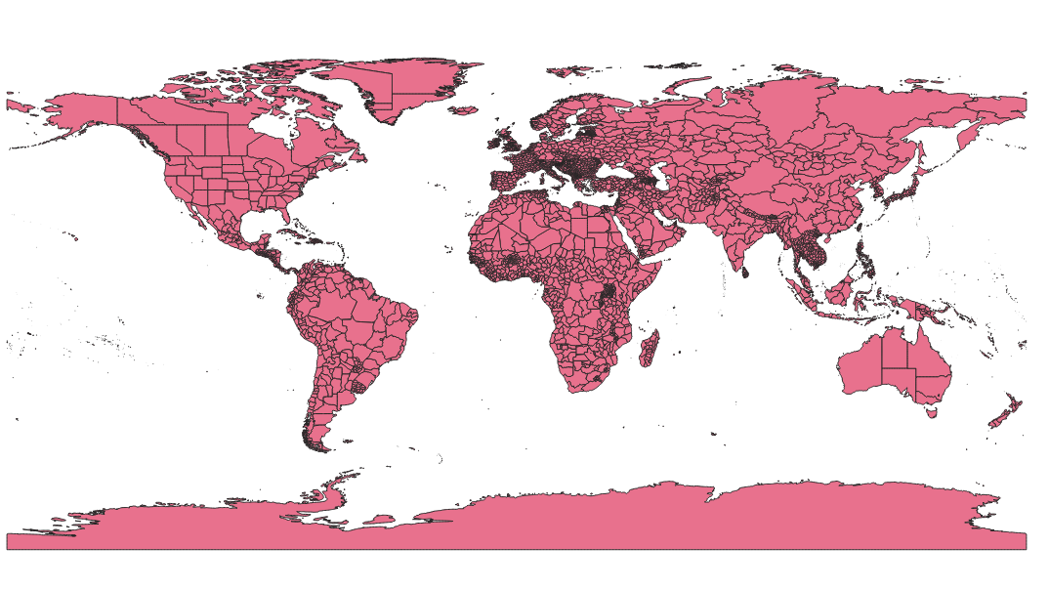
GIS fundamentals: Geographic coordinate systems (GCS)
WGS84 – Unprojected: Distortion near extents of map
Default Datum for GPS units
Pretty good for global measurements
Small changes in landmass movements can be significant at global scale
Melting glaciers cause rising elevation
Tectonic movements
Local datums are better for local maps (e.g., North American Datum; NAD83) and reduce significance of landmass movements.

Slide 7
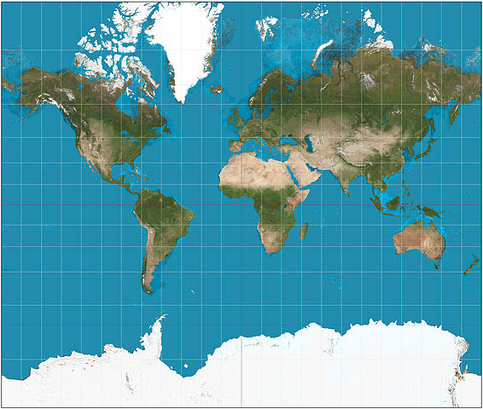
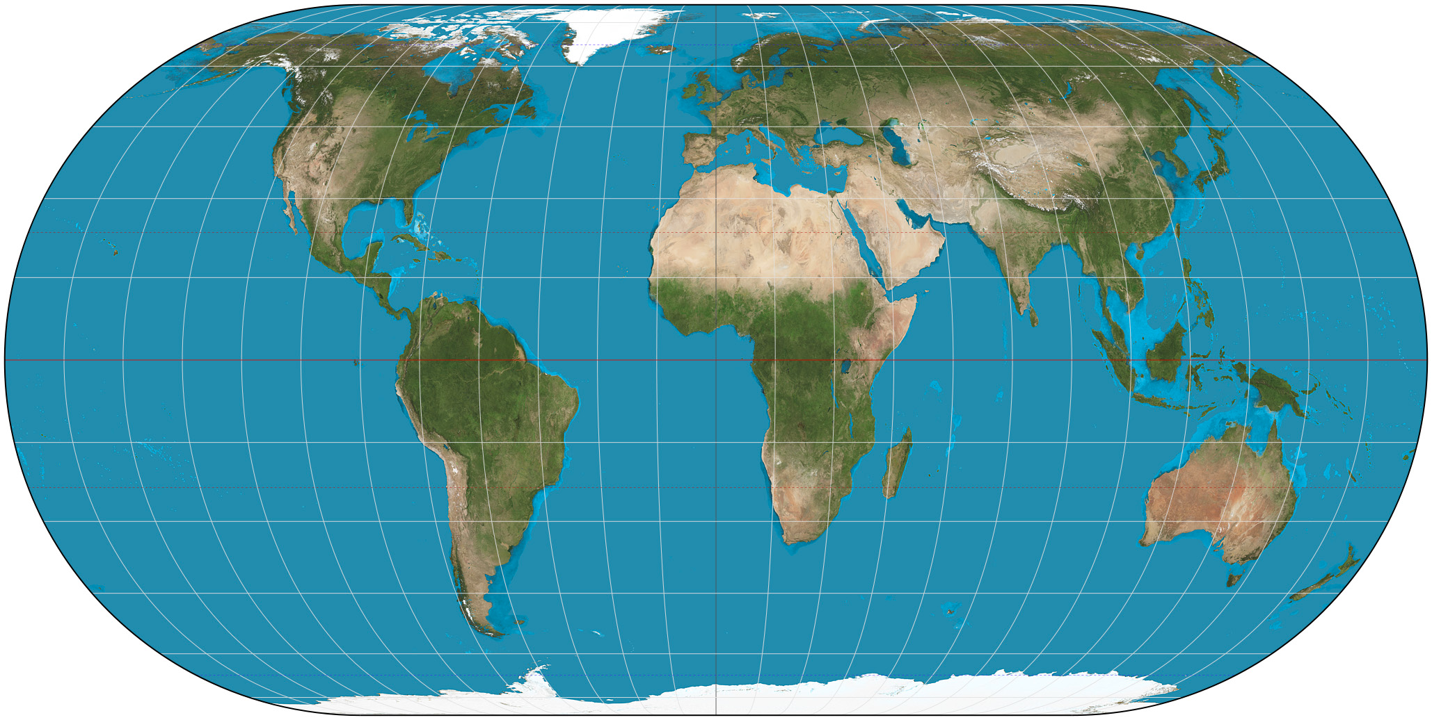
GIS fundamentals: Geographic coordinate systems (GCS)
Representing the earth's surface in two dimensions causes distortion in the shape, area, distance, or direction of the data.
Impossible to show spherical object in 2 dimensions without distortion
A map projection uses mathematical formulas to relate spherical coordinates on the globe to flat, planar coordinates.
Different projections are designed to minimize different distortions.
Eckert IV: maintains area
Mercator: maintains direction

Slide 8
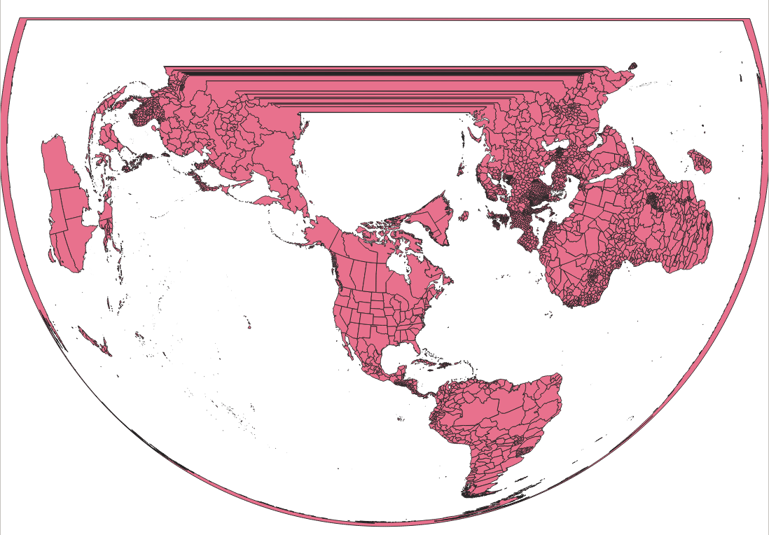
GIS fundamentals: Geographic coordinate systems (GCS)

Slide 9
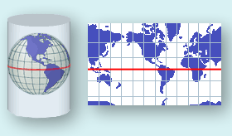
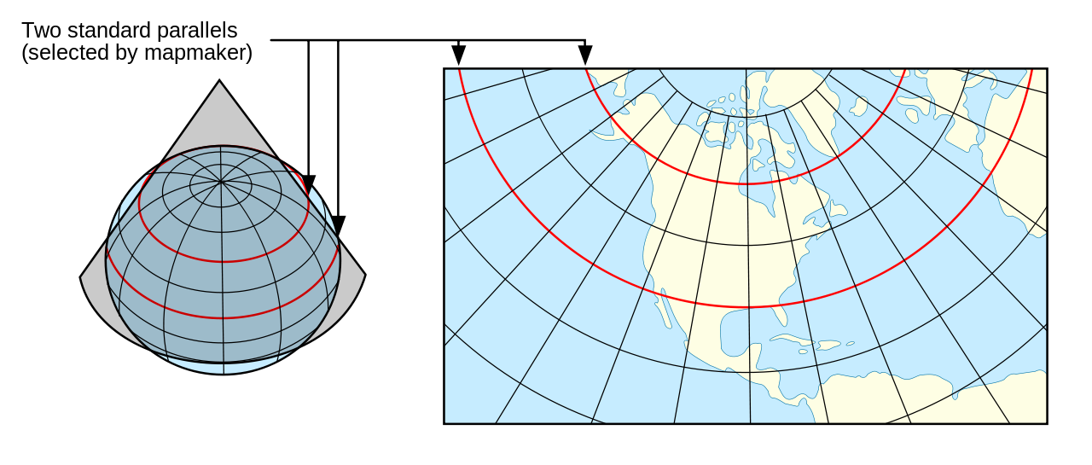

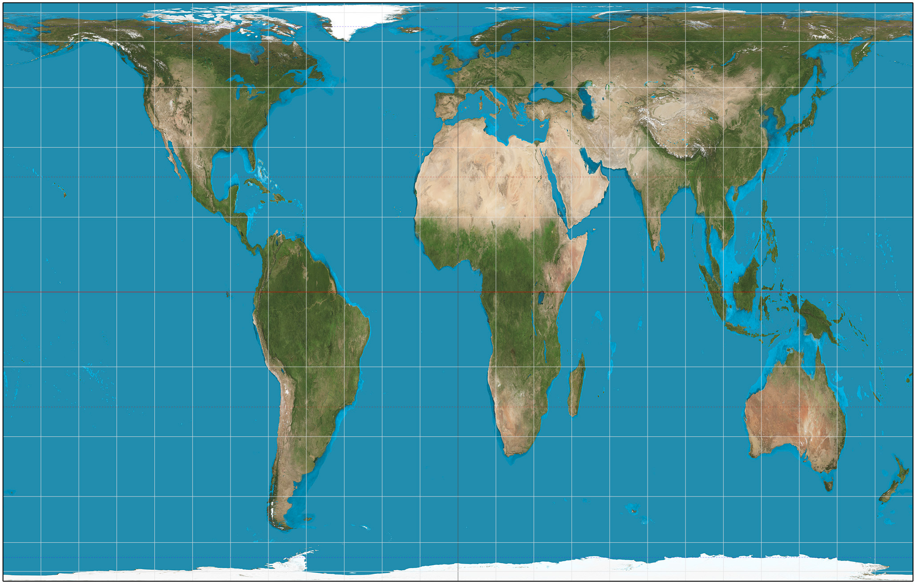
GIS fundamentals: Geographic coordinate systems (GCS)
Conic Projection
- Maintains area near center
- Distortion near edges
- Good for east/west because
distortion constant
Mercator Projection
- Maintains direction
- Good for navigating
- Distorts near pole, pretty good near equator
Gall-Peters Projection
- Maintains relative areas
- High distortion
https://thetruesize.com/

Slide 10
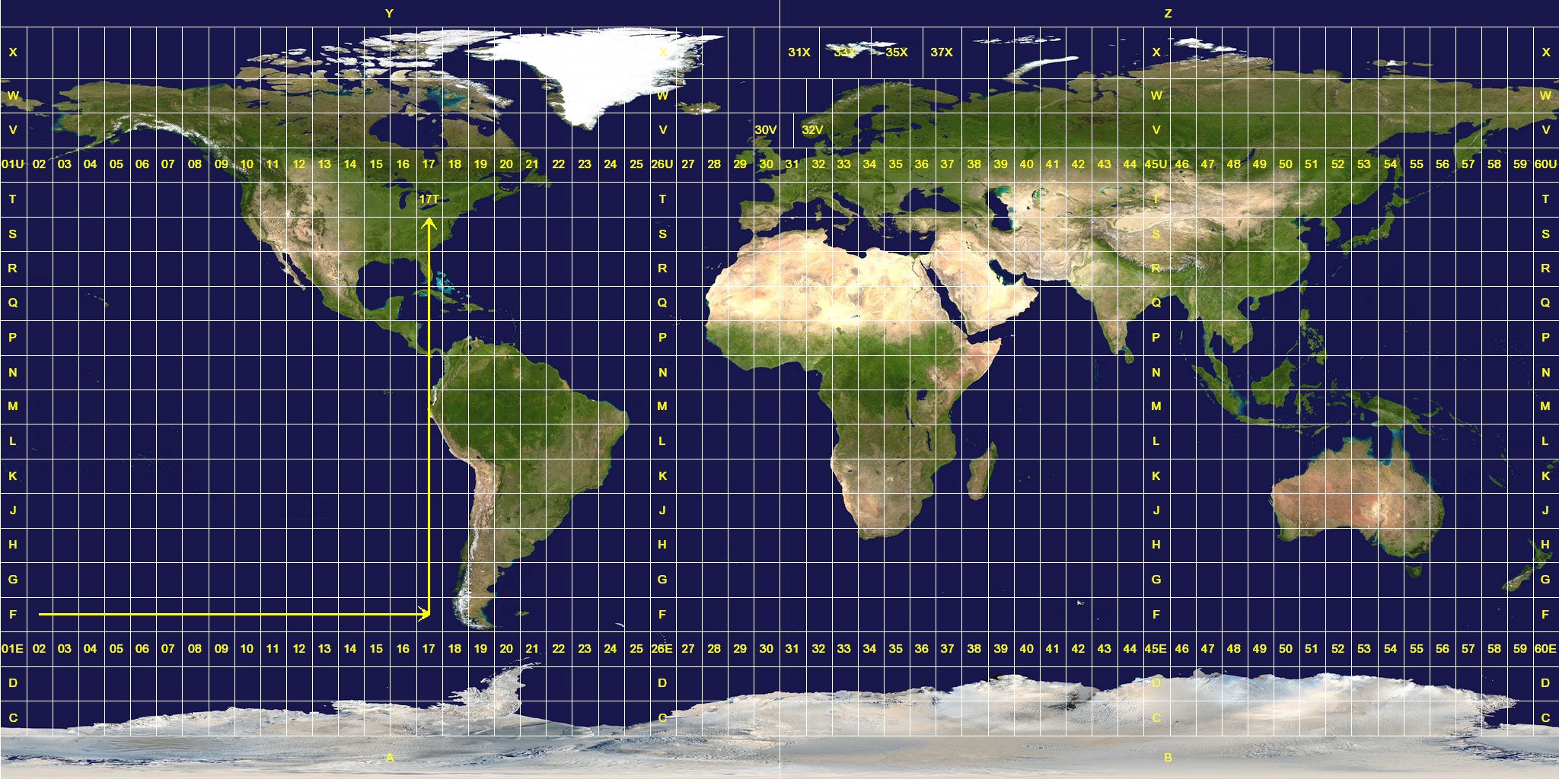
GIS fundamentals: Geographic coordinate systems (GCS)
Universal Transverse Mercator - UTM
- Highly accurate within zone
- Measurement is in meters
- intuitive
- Not great for large areas
(across zones)

Slide 11
GIS fundamentals: Geographic coordinate systems (GCS)
Modern GIS make dealing with coordinate systems relatively straightforward; however:
IT IS ESSENTIAL TO KNOW THE COORDINATE SYSTEM OF ANY DATA WITH WHICH YOU ARE WORKING!

